Slide 1
Software Engineering and Architecture
Broker IPC over HTTP

Slide 2
History
In the 1990, there was a lot of hype about building distributed systems in the OO paradigm / Broker based
CORBA
  Version 1 - 1991
Microsoft DCOM
  About the same time ☺
.Net remoting / Java RMI
Struggled with firewalls, security issues, architectural mismatch; and rather heavy-weight tooling

Slide 3
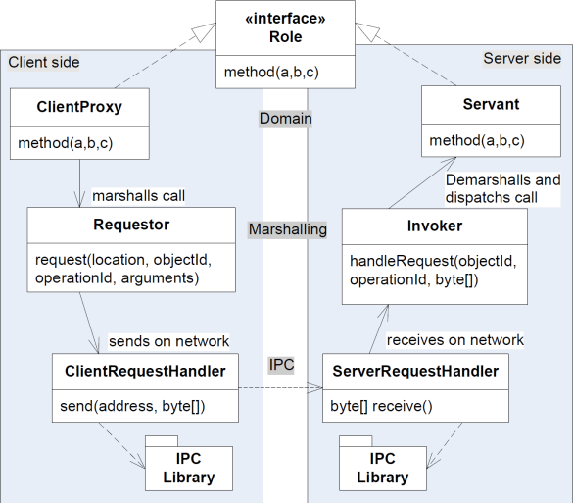
Broker again
CORBA/DCom are Broker implementations
  IPC Transport bytes
    TCP-IP based, IIOP protocol (Corba/Java RMI)
  Marshalling Encode msg
    IIOP
  Proxy and Servant Programming
    IDL compiler, generates ”stub” (proxy) and ”skeleton” (invoker + superclass for servant)
  Name Services Find object
    Naming Service (Corba)
    RMIRegistry (Java)
Notes:
All these mentioned are CORBA’s

Slide 4
Then Came WWW!
Web was built for humans to browse web pages
But it is a strong infrastructure in its own right
  Network of named computers/resources
    URLs
  Well defined protocol
    HTTP over TPC-IP,
    … and XML
  Strong infrastructure support
    Apache Tomcat, Microsoft IIS, IBM WebSphere,
    Eclipse Jetty, Java Servlets, JBoss, …
”Name Service”
IPC
Marshalling
Reliability
Learnability

Slide 5
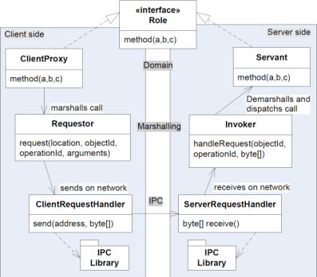
Many of the pieces
WWW as foundation for a Broker?
  IPC Transport bytes
    TCP-IP connected machines talking HTTP
  Marshalling Encode msg
    XML in HTTP messages
  Proxy and Servant Programming
    Missing – not the intent of WWW
  Location and Naming Find object
    URLs defining resources = data/information

Slide 6
The missing piece
What to do with no programming / domain layer?
Option 1: Program without it
    Implement ‘doGet’ and ‘doPost’ (servlets), demarshall XML
    Implement HTTP requests (client), marshall XML
Option 2: Make a Broker on top of www
  Simple Object Access Protocol / SOAP
  Or FRDS.Broker’s URI Tunneling Broker
Option 3: Do something completely different ☺
  REST…
Tedios, error prone, low level
Reuse, but...

Slide 7
WebServices: SOAP
Simple Object Access Protocol
(Simple???)
The short version
(A longer one at the end of the slide deck)

Slide 8
Broker
The Broker implementations in ‘web services’ tech stack
  IPC Transport bytes
    TCP-IP based, HTTP protocol
  Marshalling Encode msg
    SOAP – on the wire XML format
      “simple object access protocol”
  Proxy and Servant Programming
    WSDL = Web Service Description Language (XML)
  Location and Naming Find object
    UDDI = Universal Description, Discovery and Integration

Slide 9
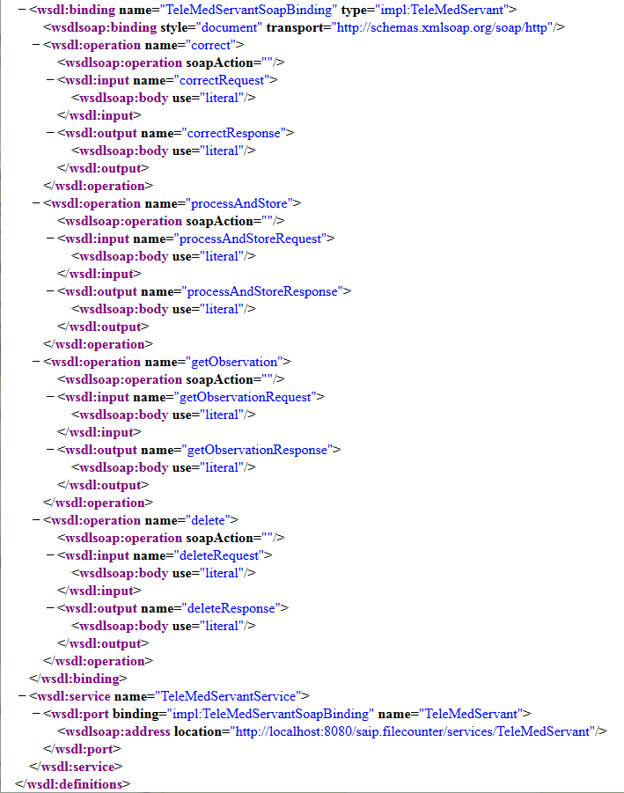
The Short Version
You generate WSDL from your (java) interface
  Heavy tooling, and produce tons of un-analyzable code ☹
  Vendor lock-in to UDDI servers
  Does not utilize HTTP’s built-in potential
  at all, it is just a way to punch through
  firewalls…

Slide 10
FRDS.Broker using HTTP

Slide 11
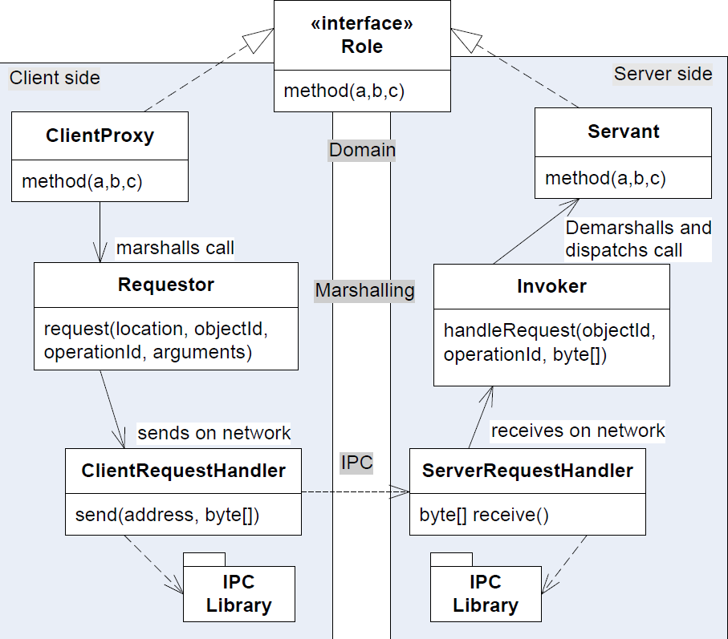
New Delegates in Broker
Easy –
  Just replace the
  RequestHandlers
  with HTTP delegates
UniRest
SparkJava

Slide 12
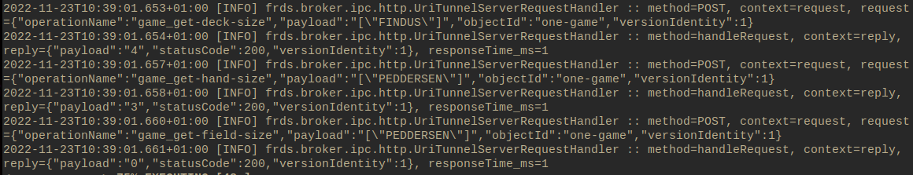
POST Command Objects
All method calls are considered command objects that the ClientRequestHandler POST to one particular resource on the HTTP Server
POST /hotstone
  Body: Marshalled request (objId, OpName, arguments)

Slide 13
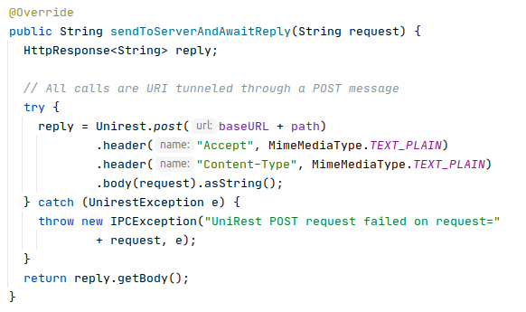
CRH
POST to URL with the marshalled request
This is the standard implementation in the Broker library

Slide 14
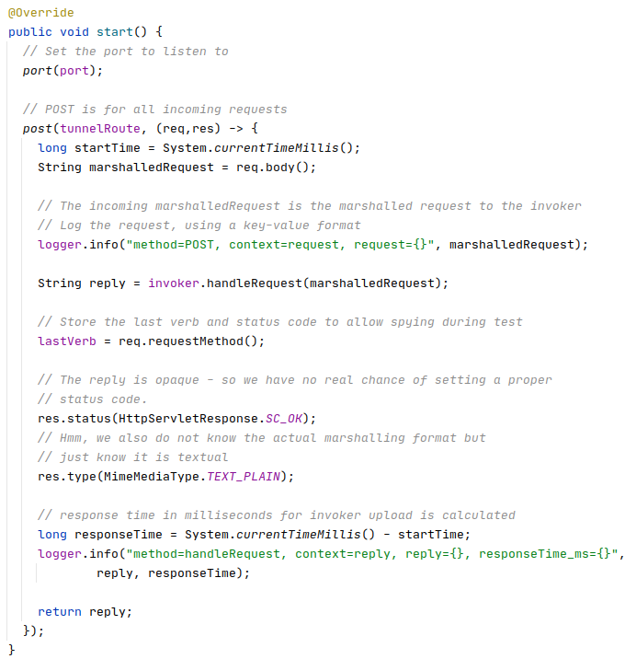
And SRH
Accept POST
Do upcall
… and reply
Standard impl. in the
library

Slide 15
Discussion
All methods are translated to POST on a single path /tunnel
  You can set another path in the Broker, but still…
That is, the Broker do not use
  HTTP verbs at all
  Resources/paths for anything
(But it does use the HTTP Status codes)
WebServices/SOAP does the same thing.
Hypermedia
HTTP
URI Tunnel

Slide 16
Discussion
Actually the URI Tunnel code is quite a lot smaller than our socket code
  And it is also multi-threaded, as SparkJava is based on Jetty which has a multi-threaded implementation…
    Starts with a pool of 8 threads, but can increase to 200…
Again, reusing well engineered frameworks saves time, money, and agony ☺

Slide 17
WebServices: SOAP
Simple Object Access Protocol
(Simple???)
The long version…

Slide 18
Broker
The Broker implementations
  IPC Transport bytes
    TCP-IP based, HTTP protocol
  Marshalling Encode msg
    SOAP – on the wire XML format
  Proxy and Servant Programming
    WSDL = Web Service Description Language (XML)
  Location and Naming Find object
    UDDI = Universal Description, Discovery and Integration

Slide 19
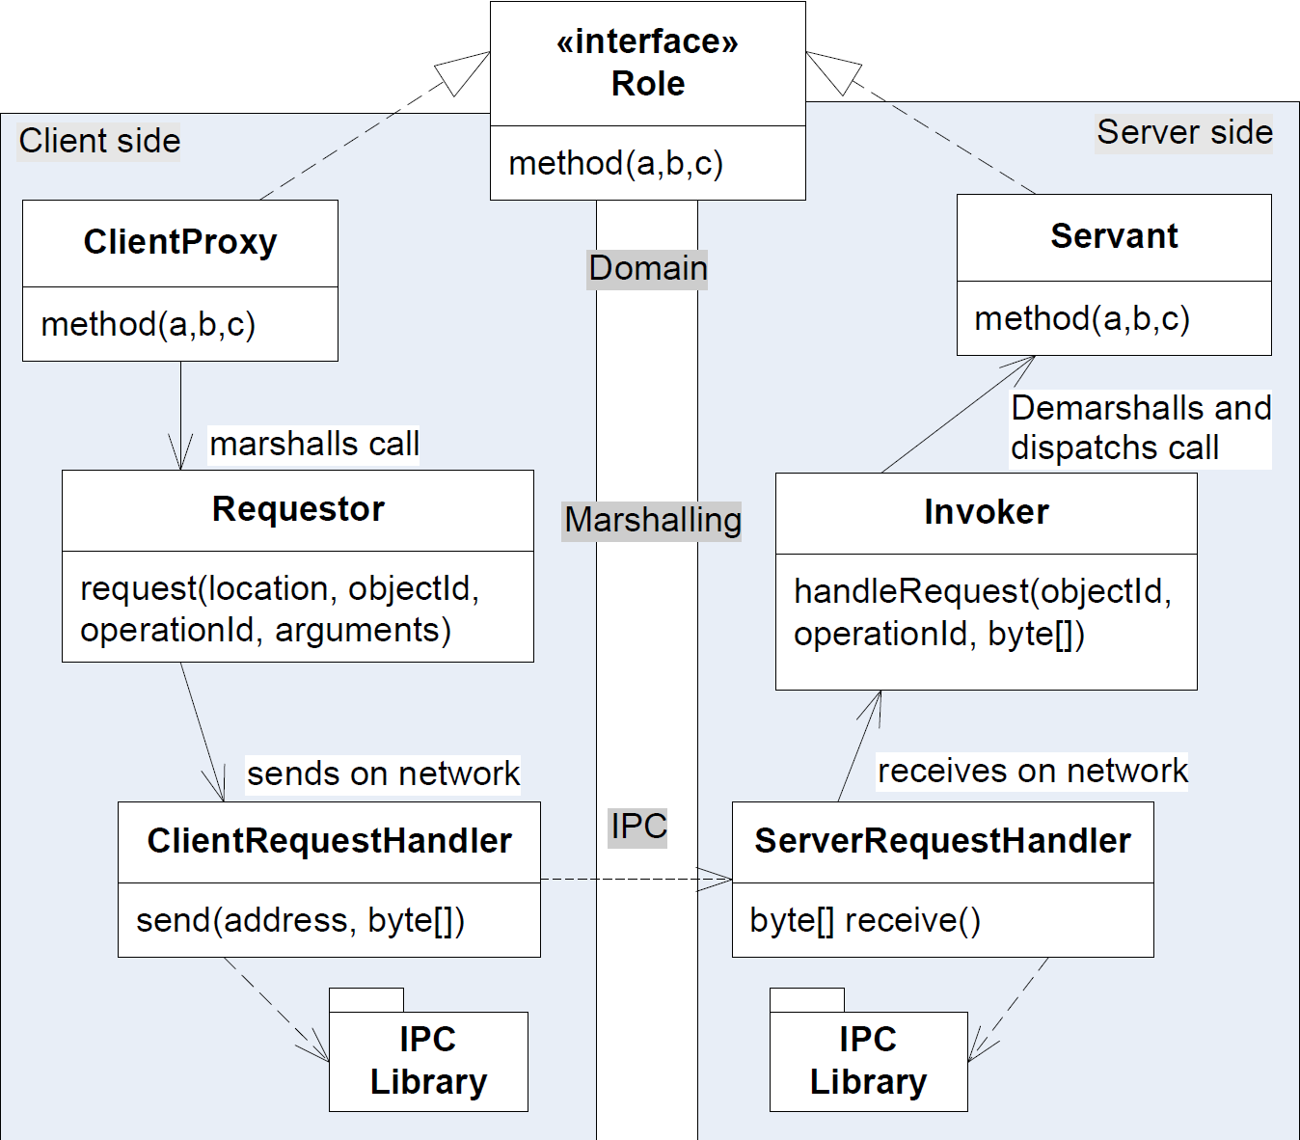
The three layers
WSDL
URLs + SOAP
HTTP

Slide 20
Example: TeleMed in SOAP
Learning Goal: Produce WSDL for TeleMed
I…
  Browsed heavily to find Eclipse tutorials
      http://www.vogella.com/tutorials/EclipseWTP/article.html
      http://www.java2blog.com/2013/03/soap-web-service-example-in-java-using.html
    Copy-n-Pasted TeleMed interface + few Domain classes into project on a VM (avoid polluting my machine’s IDE)
    Nullified actual implementations
      No business functionality, not the architectural question

Slide 21
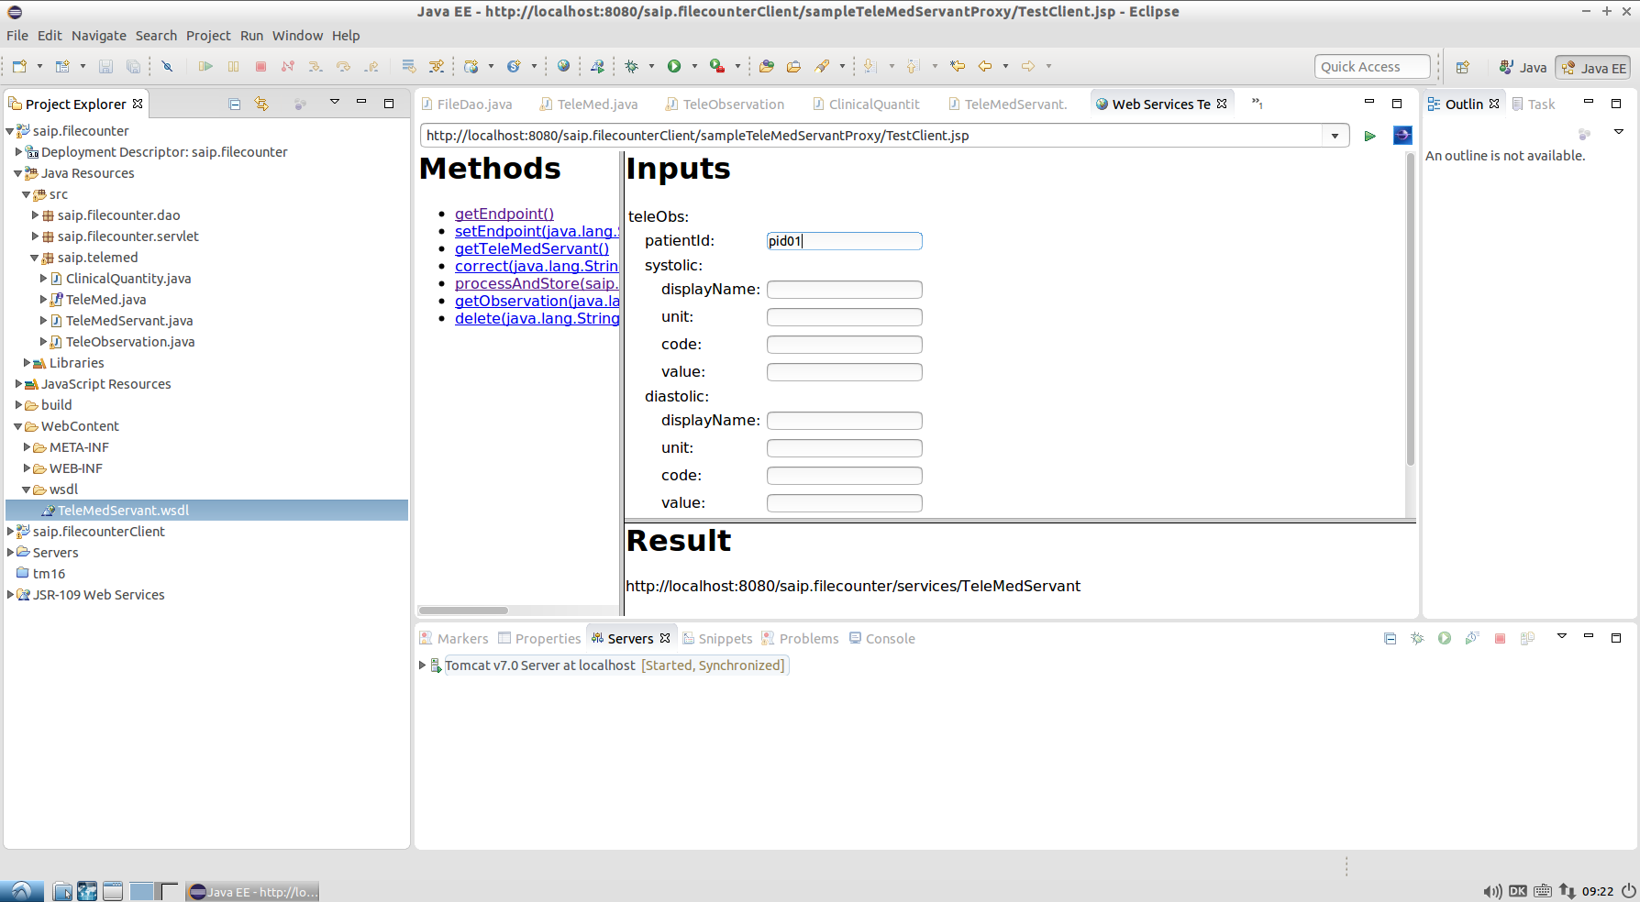
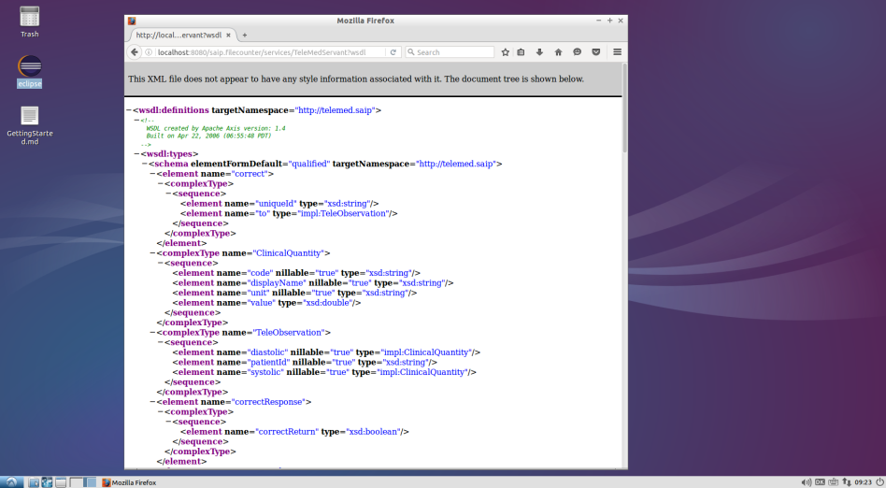
Example

Slide 22
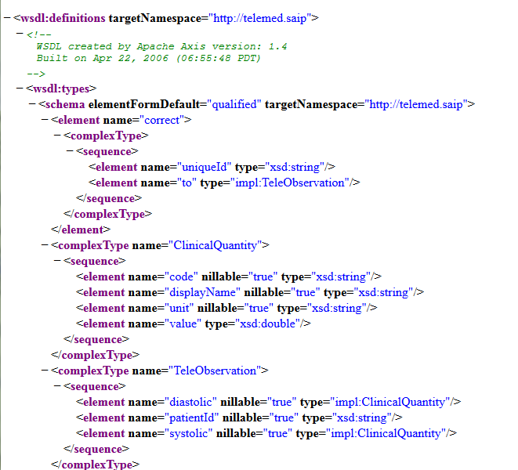
WSDL
Operations
Data types
Binding

Slide 23
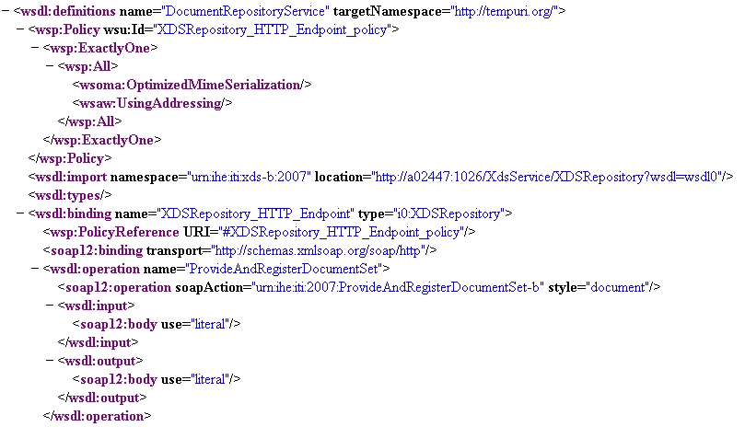
Another example
IHE XDSb Repository WSDL

Slide 24
Why not?
Basically WSDL+SOAP+UDDI is the Broker which simply use WWW and HTTP as raw IPC
  Aka URI Tunneling
  Avoid the firewall and security issues though
But it is heavyweight
  Tool intensive to make even simple service
  Bulky message format, low analyzability
  Does not utilize HTTP’s built-in potential at all, it is just a way to punch through firewalls…

Slide 25
Richardson’s Maturity model
From low maturity to high maturity
  URI Tunnel
    Just use HTTP as IPC layer
      SOAP, WSDL, WebServices
      And our URI Tunnel Broker!
  HTTP
    Use CRUD Verbs on resources
  Hypermedia
    Use links to define workflows
    Aka ‘HATEOAS’
Hypermedia
HTTP
URI Tunnel

